Slide 1

VAAL UNIVERSITY OF TECHNOLOGY | 2026
HealthCARE
AI
AI-assisted hospital admissions analysis and medical condition prediction
Business Analysis 3.2 • AIBUY3A
Faculty of Applied and Computer Sciences
Lecturer: Mr. MA Matsela | Moderator: Mrs. MA Matyila
Group: Ai integration into Healthcare | Assessment date: 02 November 2026
EXPLORE • PREDICT • TEST
Notes:
Introduce the group, the module and the project title. HealthCareAI analyses hospital admission data and tests honestly whether the condition can be predicted.

Slide 2
The idea in 30 seconds
01 | OVERVIEW
Turn hospital admission records into clear insight, and test honestly what AI can predict from them.
01 EXPLORE
02 PREDICT
03 TEST
Clean 55,500 admissions and show patterns in tables and charts.
Random Forest predicts one of six medical conditions per admission.
Evaluate on 9,908 unseen patients and compare with baselines.
49,904
6
16.6%
clean admissions modelled
medical conditions
test accuracy = chance level
A working prototype: three command-line steps + a Streamlit web interface.
Notes:
Three steps: explore the data, predict the condition, test on unseen patients. The headline result is honest: accuracy equals chance.

Slide 3
The problem: hospital data is hard to turn into insight
02 | BUSINESS CASE
Large records, slow manual analysis, and a risk of trusting models that do not really work.
MANUAL EFFORT
LOW VISIBILITY
FALSE CONFIDENCE
Staff must go through admission and billing records by hand.
It is hard to see how admissions, costs and patient groups relate.
A model can show high accuracy that disappears on new patients.
Project opportunity
Automate data cleaning and analysis, build a prediction pipeline, and test it on unseen patients so the organisation knows exactly what the data can and cannot support.
Notes:
Hospitals hold huge amounts of data. Manual analysis is slow, and AI models can look impressive until they are tested properly.

Slide 4
Business objectives and success criteria
02 | BUSINESS CASE
Measurable outputs, not just a prediction model.
1
Clean and prepare 55,500 admission records reliably.
SUCCESS SNAPSHOT
16.63%
2
Explore admissions, billing, age and length of stay.
test accuracy (best baseline 16.45%)
3
Predict the medical condition with a tuned Random Forest.
Beat baseline meaningfully:
4
Test honestly on unseen patients, against baselines.
NOT MET – reported openly
Pipeline, evaluation and documentation criteria were met.
5
Document limitations, risks and ethics of healthcare AI.
Notes:
Five objectives. The success criterion to beat the baseline by a meaningful margin was not met, and we report that transparently.

Slide 5
How HealthCareAI works
03 | SOLUTION DESIGN
One pipeline connects data preparation, machine learning, testing and prediction.
1
2
3
4
5
Dataset
Clean
Train
Test
Predict
55,500 admissions • 15 columns
names, duplicates, negative bills
one-hot + scaling + Random Forest
9,908 unseen patients
app, CLI, probabilities
Design principle: keep preprocessing inside the saved Scikit-learn pipeline (model.pkl) so training, testing and prediction use identical transformations.
Notes:
Five stages: dataset, cleaning, training, testing, prediction. The saved pipeline contains the preprocessing so every stage applies the same transformations.

Slide 6
Dataset: what the model learns from
04 | DATA & PREPARATION
A labelled hospital admissions file, cleaned step by step.
55,500
54,966
50,000
49,904
›
›
›
raw admissions
after exact duplicates
after near-duplicates
after negative bills
COVERAGE
TARGET
May 2019 to May 2024, 15 columns, no missing values.
Medical Condition: six balanced classes (16.5%–16.9% each).
INPUTS
CLEANING
Age, gender, blood type, insurer, admission type, medication, test result, bill, stay, month.
Names standardised; near-duplicates (same patient, date, bill) removed.
Notes:
55,500 raw rows. 534 exact duplicates, 4,966 near-duplicates and 96 negative bills removed, leaving 49,904 rows.

Slide 7
A fair test: split by patient + cross-validation
04 | DATA & PREPARATION
The same patient never appears in both the training and the test set.
80% TRAINING • 39,996 admissions
20% TEST 9,908
SPLIT BY PATIENT
RANDOM STATE 42
GROUPED 5-FOLD CV
Prevents the same person appearing in training and test data.
Makes the split reproducible for every run.
Checks performance across five patient-separated partitions.
The test set stays unseen during fitting and gives the headline 16.63% accuracy.
Notes:
We split by patient name. A plain random split would put copies of the same patient in both sets and inflate accuracy.

Slide 8
Inside the model: a Random Forest pipeline
05 | MACHINE LEARNING
Categorical and numeric admission features feed one ensemble classifier.
CATEGORICAL FEATURES
NUMERIC FEATURES
RANDOM FOREST
OneHotEncoder on:
• gender, blood type
• insurance provider
• admission type
• medication, test result
StandardScaler on:
• age
• billing amount
• length of stay
• admission month
Ensemble of decision trees:
• 6-class classification
• class probabilities
• feature importance
• 200 trees, depth 10
Why this approach? It handles multi-class problems with mixed feature types and reduces reliance on any single tree.
Notes:
One-hot encoding for six categorical features, scaling for four numeric features, then a Random Forest of decision trees.

Slide 9
Training and tuning workflow
05 | MACHINE LEARNING
Tuning searches for a better configuration instead of relying on defaults.
1
2
3
4
5
6
Load & clean
Engineer features
Split 80 / 20
Tune 12 combinations
Validate 5 folds
Save pipeline
Best settings found
200 trees • maximum depth 10 • minimum leaf size 5 (GridSearchCV, grouped 3-fold)
Notes:
Six steps from loading to saving the model. 12 parameter combinations with grouped 3-fold cross-validation.

Slide 10
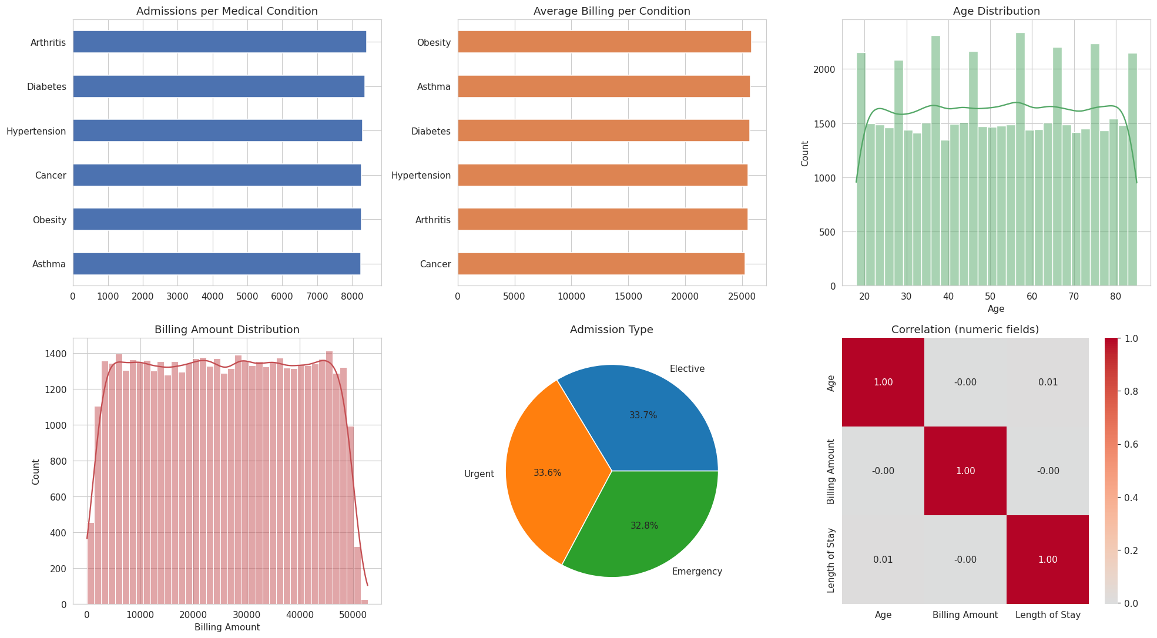
What the data shows
06 | EXPLORATION
Balanced conditions, even spreads and no correlation between fields.
Balanced
Each condition has 16.5%–16.9% of admissions.
Even bills
Average bill is about $25,500 for every condition.
No correlation
Age, billing and length of stay are uncorrelated (≈ 0.00).
Notes:
Conditions are almost perfectly balanced, ages and bills are evenly spread, and numeric fields are uncorrelated. Typical of generated data.

Slide 11
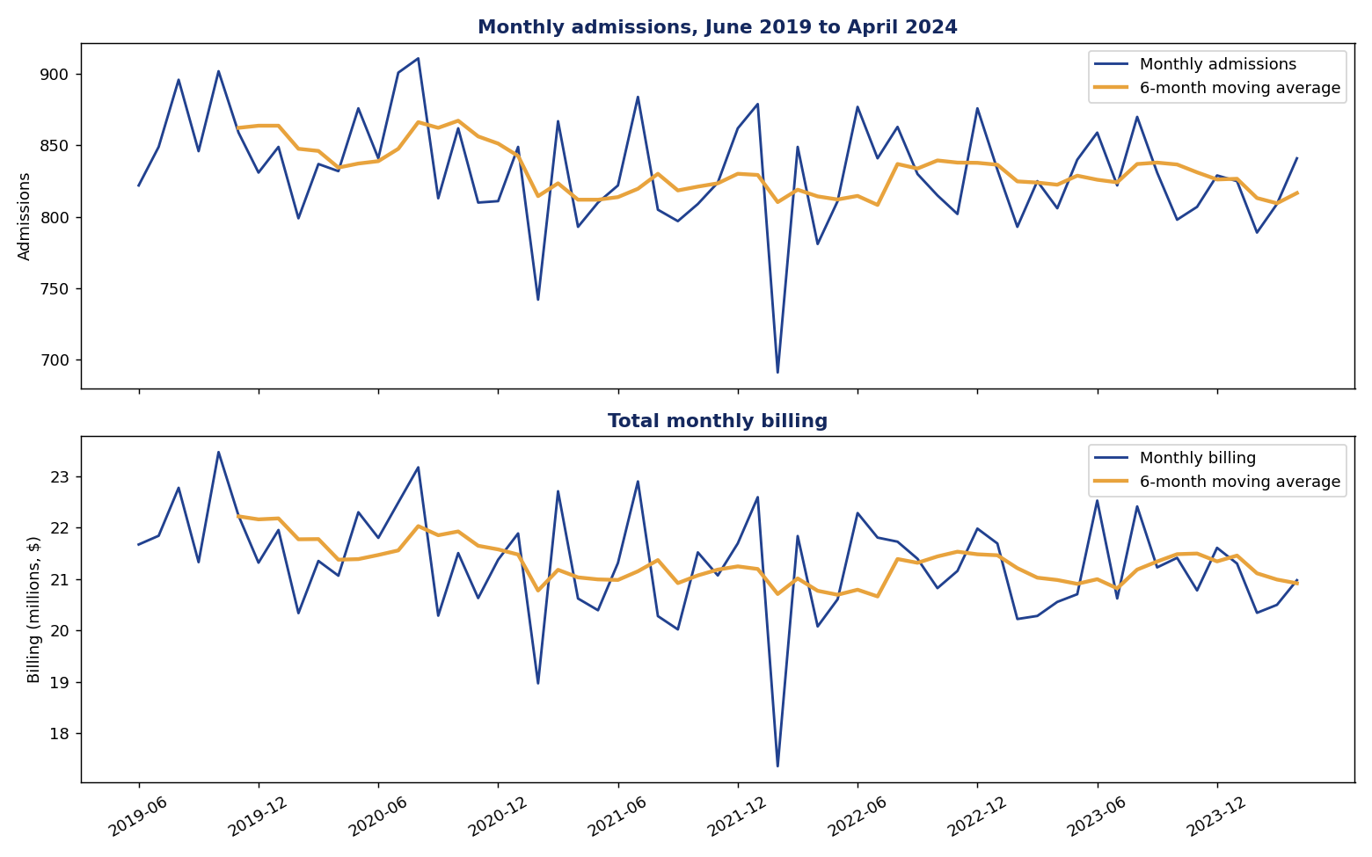
Time series: stable monthly activity
06 | EXPLORATION
59 complete months, June 2019 to April 2024.
832
$21.3M
admissions / month
billing / month
Trend: −0.56 admissions per month (p = 0.057, not significant).
Variation: about ±4.6% around the average.
Seasonality: none strong; index 98–104 (Feb lower).
Notes:
Admissions average 832 a month with little variation; billing averages about 21 million dollars a month. No strong seasonality.

Slide 12
Headline results: performance at chance level
07 | EVALUATION
Evaluated on 9,908 admissions from patients never seen in training.
16.63%
16.78%
16.66%
16.56%
Accuracy
Macro precision
Macro recall
Macro F1-score
CROSS-VALIDATION
CHANCE LEVEL
16.40%
16.67%
mean accuracy across 5 patient-grouped folds (± 0.39%)
1 in 6 classes – the model is no better than guessing
Notes:
Accuracy 16.63%, macro precision 16.78%, recall 16.66%, F1 16.56%. Chance for six classes is 16.67%.

Slide 13
Every model scores the same as guessing
07 | EVALUATION
Test accuracy (%) on unseen patients, compared with the chance level of 16.67%.
64.7%
Random Forest TRAIN accuracy
16.6%
Random Forest TEST accuracy
A large train–test gap means memorising, not learning.
Notes:
All four models are between 16.30 and 16.63 percent. The Random Forest memorises the training data (64.7 percent) but fails on new patients.

Slide 14
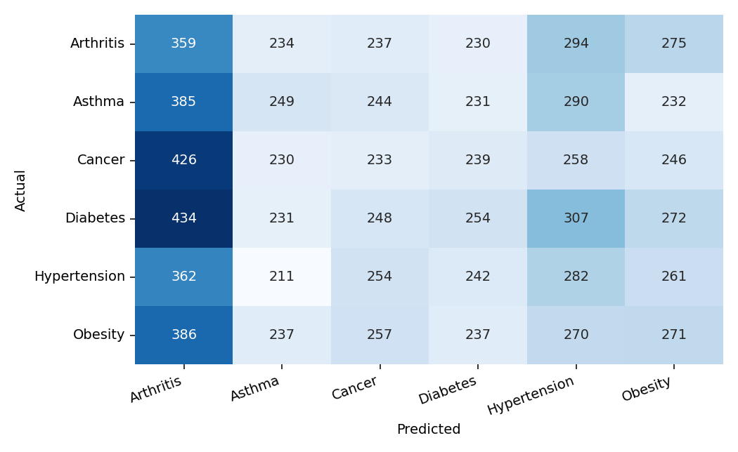
Confusion matrix: errors spread everywhere
07 | EVALUATION
Rows = actual condition, columns = predicted condition.
8,260
wrong of 9,908 (83.4%)
ARTHRITIS BIAS
Predicted for 2,352 admissions (23.7%) although only 16.4% were Arthritis. Mean confidence is just 0.18.
Notes:
Predictions are spread across all columns. The model leans towards Arthritis: predicted for 23.7 percent of admissions although only 16.4 percent are Arthritis.

Slide 15
Per-condition results
07 | EVALUATION
Precision, recall and F1-score hover around 0.17 for every condition.
Condition | Precision | Recall | F1-score | Support
Arthritis | 0.15 | 0.22 | 0.18 | 1,629
Asthma | 0.18 | 0.15 | 0.17 | 1,631
Cancer | 0.16 | 0.14 | 0.15 | 1,632
Diabetes | 0.18 | 0.15 | 0.16 | 1,746
Hypertension | 0.17 | 0.17 | 0.17 | 1,612
Obesity | 0.17 | 0.16 | 0.17 | 1,658
0.166
macro F1 (chance ≈ 0.167)
READING THE TABLE
No condition stands out. Scores near 1 in 6 on every class mean the features carry no information about the condition.
Notes:
No condition is predicted well. Arthritis has the highest recall because the model over-predicts it.

Slide 16
Feature importance: no clear driver
07 | EVALUATION
Billing, age and length of stay rank first, but only by tiny margins.
WHY NOT TRUST THIS?
Importance only says what the model used, not that it is useful. With test accuracy at chance, these scores reflect noise in continuous variables such as billing and age.
Notes:
Importances are what noise produces when the target is unrelated to the features. Continuous variables get higher scores simply because they offer more split points.

Slide 17
A lesson: how a random split misleads
08 | HONEST EVALUATION
Repeat patients and near-duplicate records leak between training and test data.
Apparent accuracy with a plain random split
≈ 27%
True accuracy with a split by patient (used in this project)
≈ 16.6%
chance 16.67%
Fix: remove near-duplicates, split and cross-validate by patient.
Notes:
With a random split the same patient appears in both sets and the forest recognises them: about 27 percent accuracy. Split by patient and the true value is about 16 percent.

Slide 18
What users can do with the prototype
09 | USER EXPERIENCE
Three scripts and a web interface support analysis, testing and prediction.
COMMAND LINE
STREAMLIT APP
REPORTING
• python train.py
• python test.py
• python predict.py
• batch CSV or interactive
• Dashboard with KPIs
• Prediction form
• Probability chart
• Model results page
• Tables saved as CSV
• Graphs saved as PNG
• Workflow diagram
• results/report.html
Typical journey: run the three steps → review tables and graphs → predict a patient → read the probabilities and disclaimer.
Notes:
train.py, test.py and predict.py plus the Streamlit app. Everything produces tables and graphs and a combined HTML report.

Slide 19
Technology stack and project files
10 | IMPLEMENTATION
A lightweight Python stack for data, modelling and the web interface.
Python 3
Pandas + NumPy
Scikit-learn
Joblib
Core language
Cleaning and numerics
Pipeline, Random Forest, tuning, metrics
Save and load the model
Streamlit
Matplotlib + Seaborn
Git + GitHub
VS Code
Browser interface
Charts and diagnostics
Version control
Development environment
Notes:
Python, pandas, scikit-learn, joblib, Streamlit, matplotlib and seaborn, Git and VS Code.

Slide 20
Risks are part of the design
11 | RISKS & RESPONSIBILITY
Hospital data is sensitive and a wrong prediction can mislead people.
MISCLASSIFICATION
DATA LEAKAGE
Wrong condition shown.
Mitigation: show probabilities; do not use on real patients until validated.
Inflated accuracy.
Mitigation: near-duplicates removed; split by patient.
PRIVACY
OVER-RELIANCE
Hospital data is sensitive.
Mitigation: local processing, no names as features, consent, POPIA.
Staff may trust the output.
Mitigation: disclaimer, confidence and limitations shown.
Not a diagnostic tool. The dataset appears synthetic, so results must not be generalised to real patients.
Notes:
Misclassification, leakage, privacy and over-reliance, each with a mitigation. The system is decision support only, not diagnosis.

Slide 21
A practical roadmap for the next version
12 | ROADMAP
Fix the data first, then add advanced features.
PHASE 1 • TRUST
PHASE 2 • ACCESS
PHASE 3 • FORECAST
• Real, ethically approved clinical data
• Clinical features (vitals, labs)
• Validation by clinicians
• Privacy and consent (POPIA)
• Free-text clinical notes (NLP)
• Speech dictation
• Chatbot for staff queries
• Accessibility improvements
• Admissions and bed forecasting
• ARIMA / LSTM models
• Seasonal pattern detection
• Medical image input (CNN)
NLP, speech and deep learning are future enhancements, not features of the current version.
Notes:
Phase 1 real clinical data and validation, Phase 2 access features such as NLP and chatbot, Phase 3 forecasting.

Slide 22
Suggested live demonstration
13 | DEMONSTRATION
Show the whole workflow in a short, controlled sequence.
1
Train
2
Test
3
Report
python train.py – tables and charts appear.
python test.py – metrics and confusion matrix.
Open results/report.html.
4
Predict
5
App
6
Discuss
python predict.py – five unseen patients.
streamlit run app.py – dashboard and form.
Explain why accuracy equals chance.
Keep a backup of the results folder and screenshots in case the live environment is unavailable.
Notes:
Run the three scripts, open the report, then show the web app prediction. Keep screenshots ready as backup.

Slide 23
Group Ai integration into Healthcare
14 | OUR TEAM
Business Analysis 3.2 • AIBUY3A • Vaal University of Technology
TK
SC
F
NM
T.K Mbhokota
S.C Mahlaule
F Ngonyama
N.M Makoko
240900138
223261351
223100846
223553921
A
O
NE
O
A Moshoadiba
O Hlungwani
NE Mhlongo
O Mthombeni
224879812
223328480
240829735
240219708
Notes:
Introduce each team member.

Slide 24
From data to honest decisions
15 | CONCLUSION
HealthCareAI shows how to build, test and report an AI solution responsibly.
WHAT WORKS
WHAT NEEDS CARE
A complete, reproducible pipeline: cleaning, analysis, training, testing and prediction with tables, graphs and a web interface.
Accuracy (16.6%) equals chance: the dataset appears synthetic and has no clinical signal. Real data is needed.
Our key outcome: preventing data leakage and testing against baselines showed what the data cannot support – before anyone relied on it.
Notes:
What works: the pipeline, analysis and honest testing. What needs care: the dataset has no signal, so prediction cannot be relied on.

Slide 25
DISCUSSION
Questions?
We welcome questions about the business problem, data, model design, evaluation and limitations.
HealthCareAI
AIBUY3A • Business Analysis 3.2 • VUT 2026
Notes:
Invite questions on the business problem, data, model, evaluation and limitations.

